Slide 1
Verification & Validation

Slide 2
TESTING
TESTING
DYMANIC
STATIC

Slide 3
Types of Testing
Two approaches to achieve test objective
1.Static Testing
-Software work products are examined manually or with a set of tools, but not executed
2.Dynamic Testing
-Software is executed using a set of input values and its output is then examined and compared to what is expected

Slide 4
Verification versus Validation
Verification
Did you build the product right?
That is, did you meet the requirements specification?
Validation
Did you build the right product?
That is, did you meet the operational need?

Slide 5
VERIFICATION
TESTING -5

Slide 6
Verification
Purpose:
Ensure that selected work products meet their specified requirements.

Slide 7
Validation
TESTING -5

Slide 8
Validation
Purpose:
Demonstrate that a product or product component fulfills its intended use when placed in its intended environment.

Slide 9
Static Testing
TESTING -5

Slide 10
Static Testing
Testing of a component or system at specification or implementation level without execution of that software
Ex: Reviews or static code analysis

Slide 11
How to evaluate or analyze the following work products?
Requirement documents
Test plan documents
Design documents
User manual
Source code before execution
Is it possible to test using Dynamic testing?
NO
One powerful technique used in static testing –REVIEWS
Note:
Static Testing is not replacement for Dynamic Testing

Slide 12
Types of defects that are easier to identify in Static Testing
Deviations from standards
Missing Requirements
Note:
In contrast to dynamic testing, static testing finds defects rather than failures

Slide 13
Advantages of Static testing
Increases productivity
Increases quality
Reducing no of defects early in the life cycle
-Less time to spent on testing and maintenance
-Effort and cost for Rework are low
Note:
Static Testing is not a replacement for Dynamic Testing

Slide 14
Review
An Evaluation of a Product or project status to ascertain discrepancies from planned results and to recommend improvements .

Slide 15
Objectives of Reviews:
Finding defects
Informational, communicational and educational whereby participants learn about the content of the software work products to help them understand the role of their work and plan for future stages of development
Represents project milestones
Support establishment of a baseline for a software products
Gathering Customer Feedback

Slide 16
Categories of Review
Informal Reviews
Formal Reviews

Slide 17
Formal Review:
A review characterized by documented procedures
and requirement
Informal Review:
A review not based on formal procedure
Not documented

Slide 18
Roles & Responsibilities
Moderator
Author
Scribe
Reviewers
Manager

Slide 19
Moderator
Leads the review process
Determine type of review, approach, composition of review team
Performs entry check & follow up rework
Schedule the meeting, leads possible discussions,coaches the team, stores data that is collected

Slide 20
Author
Writer of the document under review
Goal is to learn as much as possible to improve the quality of future documents
Author’s task is to illuminate unclear areas & to understand the defects found

Slide 21
Scribe
During logging meeting, the scribe(recorder) has to record each defects mentioned and any suggestions for process improvement
Normally author plays this role ensuring log is readable and understandable
However some one other than author can take the role of scribe(eg Moderator) can have significant advantages

Slide 22
Reviewer
The task of the reviewers (also called checkers or inspectors) is to check any material for defects, mostly prior to the meeting.
In addition to the document under review, the material review-ers receive includes source documents, standards, checklists, etc.
The level of domain knowledge or tech-nical expertise needed by the reviewers also depends on the type of review.

Slide 23
Manager
The manager is involved in the reviews as he or she decides on the execution of reviews, allocates time in project schedules and determines whether review process objectives have been met.
The manager will also take care of any review training requested by the participants.
Of course a manager can also be involved in the review itself depending on his or her background, playing the role of a reviewer if this would be helpful.

Slide 24
Types of Review
Walk through
Technical review
Inspection

Slide 25
Walkthrough
The author of the document under review guiding the participants through the document process to achieve common understanding and collect feedback
Key Characteristics of Walkthrough
Meeting is led by the author, often separate scribe is present
Scenarios and dry runs may be used to validate the content
Separate Pre-meeting preparation for reviewers is optional

Slide 26
Technical Reviews
Discussion activity that focuses on technical contents of the documents

Slide 27
Inspections
Most formal review in which documents are prepared and checked thoroughly by reviewers before the meeting, comparing the work product with its source and reference documents.

Slide 28
Testing Types

Slide 29
TESTING
TESTING
STATIC
DYMANIC
WHITE BOX
BLACK BOX

Slide 30
BLACK BOX TESTING
Testing of the inputs and outputs of a system or program without looking inside (at code) or at the internal design
Crude if done without specs, better if done with user manual, best if done with specs
Used to demonstrate
Software functions are operational
Input is properly accepted and output is correctly produced
Integrity of data is maintained

Slide 31
Black Box Testing
Attempts to find errors in the following categories
Incorrect or missing functions
Interface errors
Errors in data structures or external data base access
Behavioral or performance errors
Initialization and termination errors

Slide 32
WHITE BOX TESTING
Testing the internal logic of the module with respect to the detailed design produced as per the specification
Able to identify the defects at the early phase of life cycle
Demonstrates / tests
Against the coding standards
Structure of the program
Unreachable code
Memory leakage etc..

Slide 33
TEST LEVELS
TESTING -3

Slide 34
TEST LEVELS
COMPONENT TESTING
INTEGRATION TESTING
SYSTEM TESTING
ACCEPTANCE TESTING

Slide 35
COMPONENT
Test individual modules for its logic
White Box Testing is involved
Earlier Identification of defects reduces rework and cost

Slide 36
Integration testing
Integration testing is the phase of software testing in which individual software modules are combined and tested as a group.
Follows unit testing and precedes system testing.
The different types of integration testing :
Big Bang
Incremental Integration

Slide 37
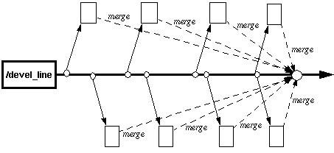
BIG BANG APPROACH
Big – Bang Integration
After all of the modules are tested they are all integrated together at once and tested

Slide 38
Disadvantages
We need to wait until all the modules are developed and unit Tested
It is difficult to Trace the cause of Failures with the late integration

Slide 39
Incremental Testing
All programs are integrated one by one and a test is carried out after each step
Advantages:
Easy to track the source of Defect
Disadvantage:
Time consuming since stubs and drivers have to be developed and used in the test

Slide 40
Categories under Incremental
Top Down
Bottom Up

Slide 41
Top - Down Integration
TOP DOWN INTEGRATION
Modules tested in isolation are the modules which
are at the highest level
Do this until all subsystems are incorporated into the test
Requires stub modules to simulate the functions of the
missing modules that may be called
However, drivers are not needed since we are starting with the modules which is not used by any other module and use already tested modules when testing modules in the higher levels

Slide 42
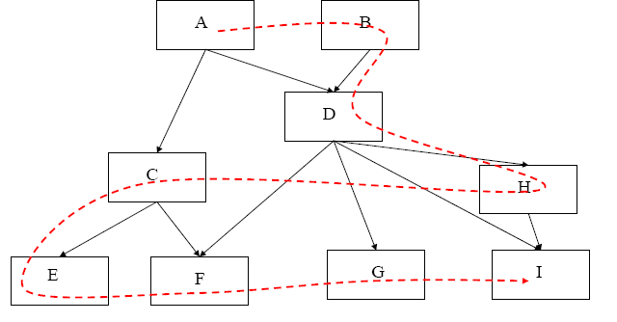
Top-down Integration

Slide 43
Bottom-Up Integration
Only terminal modules are tested in isolation
Modules at lower levels are tested using the previously
tested higher level modules
This is done repeatedly until all subsystems are included in the testing
Requires a module driver for each module to feed the
test case input to the interface of the module being tested
However, stubs are not needed since we are starting with the terminal modules and use already tested modules when testing modules in the lower levels
Disadvantage: Tests the most important subsystem last

Slide 44
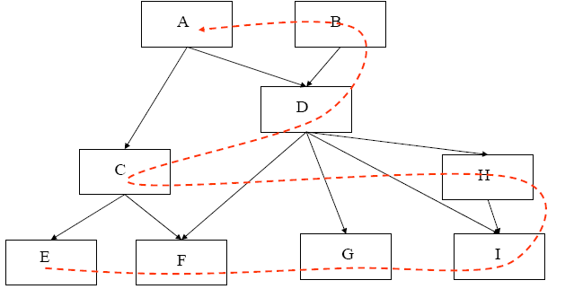
Bottom-Up Integration

Slide 45
System Testing
System Testing helps to confirm that the product meets the requirements as per system specification.
System testing is performed when the entire system is assembled after integration and has to be tested as a whole.
This is a black box type of testing and involves both functional and non-functional testing.
After all components of a product are integrated and deployed into a single build on a controlled platform that is similar to the final production platform.

Slide 46
Acceptance Testing
Acceptance testing is black-box testing performed on a
system prior to its delivery
Generally involves running a suite of tests on the completed system.
Each individual test, known as a case, exercises a particular operating condition of the user's environment or feature of the system, and will result in a pass or fail Boolean outcome.

Slide 47
TLC

Slide 48
TEST PLAN-Intro
A software project test plan is a document that describes the objectives, scope, approach, and focus of a software testing effort.
The process of preparing a test plan is a useful way to think through the efforts needed to validate the acceptability of a software product.
It identifies test items, the features to be tested, the testing tasks, who will do each task, and any risks requiring contingency Planning.

Slide 49
References for preparing Test Plan
The supporting documents for referring the test plan are:
Project Plan
System Requirements specifications.
High Level design document.
Detail design document.
Development and Test process standards.
Methodology

Slide 50
Scope
Types of Testing in Scope
Scope of testing will includes the types of testing carried in the project.
Examples:
Functional Testing or System Testing
Automation Testing
Performance Testing
Security Testing
Usability Testing
Environment Testing
Compatibility Testing

Slide 51
Types of Testing Not in Scope
This section will have those types of testing which will not be performed in the Testing life Cycle of the project.

Slide 52
Approach
It gives the overall Testing Approach.
It describes the following details
Are any special tools to be used and what are they?
Will the tool require special training?
What metrics will be collected?
Which level is each metric to be collected at?

Slide 53
How is Configuration Management to be handled?
How many different configurations will be tested?
Hardware
Software
Combinations of HW, SW and other vendor packages

Slide 54
What levels of regression testing will be done and how much at each test level?
Will regression testing be based on severity of defects detected?
How will elements in the requirements and design that do not make sense or are untestable be processed?

Slide 55
Entry & Exit Criteria
Here the test plan should explain as when the testing needs to be started (Entry Criteria) and when the test should be stopped (Exit Criteria)
The idea behind this section is that every process step be inspection, and functional test or Design has a precise entry & exit criteria

Slide 56
Suspension & Resumption Criteria
Suspension criteria specify the criteria to be used to suspend all or a portion of the testing activities
Resumption criteria specifies when testing can resume after it has been suspended.

Slide 57
Example
SUSPENSION CRITERIA | RESUMPTION CRITERIA
Urgent defects, which prevent further testing along any path. | Urgent defects are rectified
Non availability of Test data for scenarios | Test data uploaded in test environment as required to execute scenarios/cases

Slide 58
Test Deliverables
You have to define the list of deliverables which will be delivered from the testing engagement
For example –
Test Plan
Traceability Matrix
Test Cases
Test Execution Log
QA Cycle Status Report

Slide 59
2.Environment Plan
Hardware configuration
For example as mentioned below, this should be the environment which the testers will be performing the test.
This is a very critical section which is an agreement and defining the environment where the testing will be performed
Laptops (Dell) Win XP & Win 2K IE 6.0- Novel Client
Cognizant Desktop compatible to Schering GX260 Win XP IE 6.0

Slide 60
Software Configuration
Home Office Image
Research Image
Active X Control.
Note:
The above mentioned lists are the builds or setup which needs to be deployed in the testers system prior to testing.
If this is not satisfied then the entire test performed by the testers will become invalid

Slide 61
Staffing and Training Needs
Training on the application/system.
Training for any test tools to be used.
The Test Items and Responsibilities sections affect this section. What is to be tested and who is
responsible for the testing and training.

Slide 62
Test Schedule
Specify test milestones
Specify all item transmittal events
Estimate time required to do each testing task
Schedule all testing tasks and test milestones
For each testing resource, specify its periods of use

Slide 63
Risks and Mitigation Plan
Risk detail should be given in the test plan based on the category of the risks the impact will be applied
What are the overall risks to the project with an emphasis on the testing process?

Slide 64
Example:
Lack of personnel resources when testing is to begin.
Lack of availability of required hardware, software, data or tools.
Late delivery of the software, hardware or tools.
Delays in training on the application and/or tools.
Changes to the original requirements or designs.
Complexities involved in testing the applications

Slide 65
Roles & Responsibility
Identify groups responsible for managing, designing, preparing, executing, witnessing, checking and resolving.
Identify groups responsible for providing the test items identified in the Test Items section.
Identify groups responsible for providing the environmental needs identified in the Environmental Needs section

Slide 66
Reference to Templates
This section should give reference to the templates for the following:-
Test cases
Review check list for Test cases
Test Incident Report
Test Summary Report

Slide 67
Test Case
It is a document which identifies the various tests required to ensure that the system covers all the requirements for the customer.
Test cases follow agreed standard format.(This will be based on the agreed upon format specified in the QAP or as specified in the Standards and Guidelines document)

Slide 68
Test Case Design
Test cases are designed to ensure complete coverage of the software components under different environmental conditions and data inputs
Test cases should exist for checking Performance of various operations e.g. data retrieval and updation, report printing
Test cases should exist for covering error conditions that can occur
Test data should be mentioned explicitly for each test condition

Slide 69
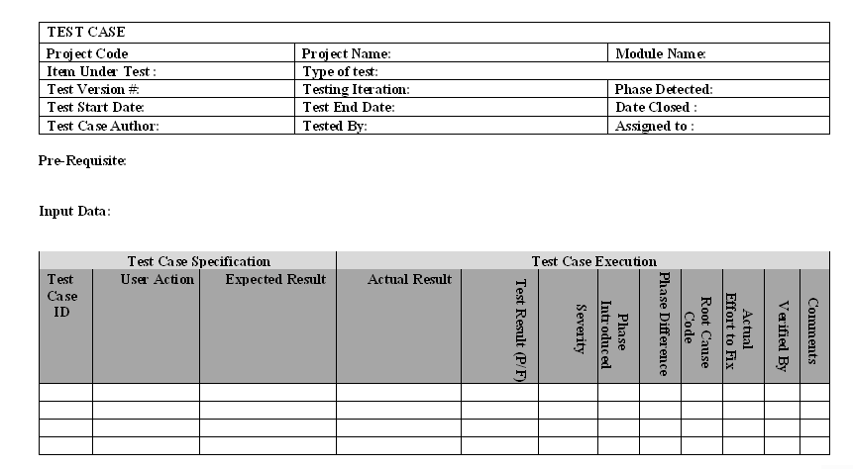
Test Case Template (Standard )

Slide 70
Defect Tracking/Closure
Defect Identified by the Tester
Entry made in the DTS Web by Tester
DTS Web can be accessed by Developers/Testers
Summary of the Defect and Description are entered
Severity is chosen among Fatal/Major/Minor/Suggestion
Priority could be High/Medium/Low
The initial State will be Open

Slide 71
Defect Tracking (Contd...)
Defect Analyzer - Analyses the impact of the Defect
Assigns to the concerned team with person responsible
DA - Informs the concerned person
Further Comments can be given in the Description
DA enters the Phase introduced, detected and Root Cause Codes

Slide 72
Defect Tracking (Contd...)
Assigned team member fixes the defect
On resolution DA changes the defect to Under QC
QC reviews and tests the impacted items
If review ok the defect state is changed to Fixed
Changed files are checked-in to the VSS by CC
If review failed, its again assigned to the concerned team
DA informs the initiator to check for closure of the defect
Initiator confirms the Defect is actually fixed for Closure

Slide 73
Queries

